Slide 1
Java Lecture 8

Slide 2
Java Basics
Function:-
      A function is a block of code that performs a particular task and may or may not return a value.
Types of functions:
  Inbuilt function.
    Math.sqrt()
    Math.PI()
  User defined function.

Slide 3
Java Basics
    Syntax User defined function.
      Declaration:
      return-type method-name ( arguments );
      Definition:
        return-type method-name ( arguments )
        {
        //function body
        }
      Example:
        int fac(int n);

Slide 4
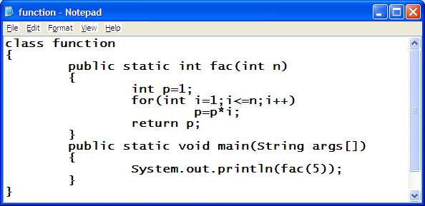
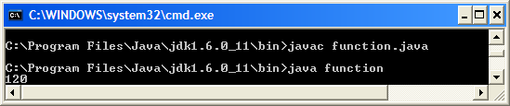
Java Basics
function:

Slide 5
Java Basics
Recursion:
    A method of programming where a function directly or indirectly calls itself.
Types of recursion:
    DIRECT RECURSION
    INDIRECT RECURSION

Slide 6
Java Basics
Direct recursion:
    A method of programming where a function directly calls itself.
Indirect recursion:
    A method of programming where a function indirectly calls itself.

Slide 7
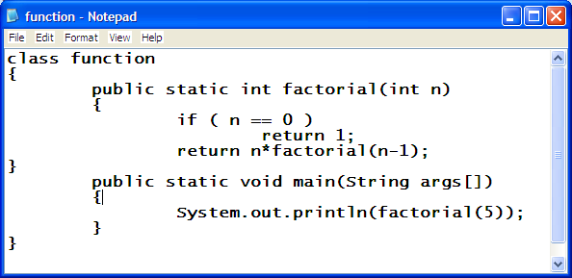
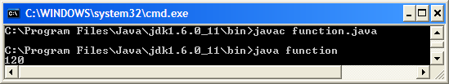
Java Basics
Example of Recursion:

Slide 8
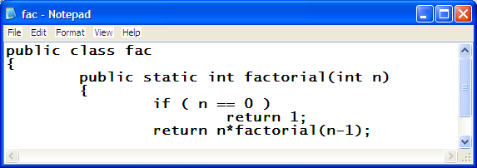
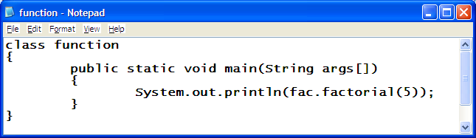
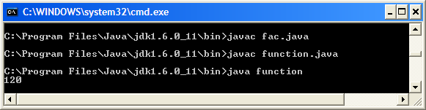
Java Basics
Calling function of other program:

